Slide 1
Problems
Week 1 Feb 3rd

Slide 2
Types of Computer
There are many different types of computer:
general purpose - PCs, Laptops etc
specialised - servers, routers,microcontrollers

Slide 3
Functions
In general computers can do four things:
Input (accepts data)
Processing (processes data)
Output (produces output)
Storage (save results)

Slide 4
Example
Using one specific computing device (i.e. your smart phone) give examples of these four functions in action:
Type of Computer:
1.Texting
2.Taking Photo
3.Viewing Photos in Gallery
4.Using a word procesor

Slide 5
Why Computers?
What advantages/disadvantages are there when using a computer for a task, compared to a human?
Advantages | Disadvantages
more precise | staff need extra training to operate them
can repeat tasks accurately | initial expense high
don’t need to be payed | may only be suitable for one task
don’t need breaks | can’t cope with unfamiliar situations
don’t argue with orders | can’t be moved easily

Slide 6
List some Apps that are used for...
Storing of information
Cloud
Email

Slide 7
List some Apps that are used for...
Retrieving information

Slide 8
List some Apps that are used for...
Sending or communicating information

Slide 9
List some Apps that are used for...
Modifying or transforming information.
Word
Excel

Slide 10
Hardware/Software
What is the difference between hardware and software?
Hardware is the physical pieces eg;mouse, keyboard, monitor, motherboard etc.
Software is programmes run on the computer eg; microsoft word, excel, powerpoint, games

Slide 11
What are the following for?
CPU - Central Processing Unit
GPU - Graphics Processing Unit
RAM - Random Access Memory
Motherboard - The main circuit board providing many essential functions eg;memory, CPU
Hard Drive - Data storage device

Slide 12
Software I
What is an operating system (OS) ? List some variants.
The core software that runs the basic functions for other computer programms
Windows, Android, IOS, Linux, Unix

Slide 13
Software II
In relation to computer software, what are drivers?
Drivers are essential to allow pieces of hardware to connect to the computer eg; webcams, mouse

Slide 14
Networks
What do computer networks allow us to do?
To share information between connected computers
What is the difference between the world wide web (www) and the internet?
The internet is a huge network of computers around the world sharing information
The web is a way of accessing this information

Slide 15
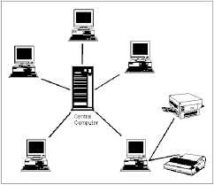
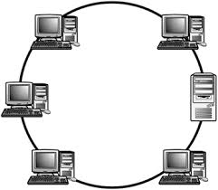
Network Topologies
What do the following network configurations look like?
Ring
Star
Bus
Which configuration do you think this lab uses?

Slide 16
Acronyms
Explain:
LAN - Local Area Network
WAN - Wide Area Network
MAN -

Slide 17
Protocols
A protocol is simply an agreed way of doing things. For instance, social protocol dictates that if someone greets you with “Dia duit” you reply with “Dia is Muire duit”
Computers have similar - albeit more robust - communication protocols.

Slide 18
What are these Protocols for?
SMTP/POP3
FTP
TCP/IP

